Slide 1
Functions

Slide 2
Function routine
A function or routine is a named group of instructions performing some task.
A routine can be invoked (called) as many times as needed in a given program.
When a routine terminates, execution automatically returns to the point from which it was called.

Slide 3
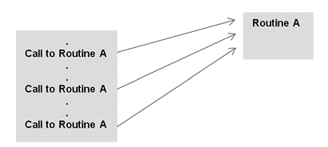

Slide 4

Defining Functions
Functions may be designed as per user’s requirement.
The elements of a function definition are given

Slide 5
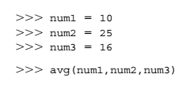
Defining Functions
The number of items in a parameter list indicates the number of values that must be passed to the function, called actual arguments such as the variables num1, num2,and num3 below.
Every function must be defined before it is called.

Slide 6
Parameters
Actual parameters, or simply “arguments,” - values passed to functions to be operated on.
Formal parameters, or simply the “placeholder” names for the arguments passed.
Actual parameters are matched with formal parameters by following the assignment rules

Slide 7
Value-Returning Functions
A value-returning function is a program routine called for its return value, and is therefore similar to a mathematical function, e.g.,
f(x) = 2x
In this notation, “x” stands for any numeric value that function f may be applied to,
f(2) = 2 x 2 = 4
Program functions are similarly used.

Slide 8
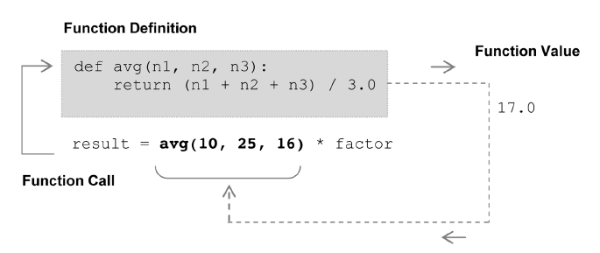
Function avg takes three arguments (n1, n2, and n3) and returns the average of the three. The function call avg(10, 25, 16), therefore, is an expression that evaluates to the returned function value. This is indicated in the function’s return statement of the form return expr, where expr may be any expression.

Slide 9
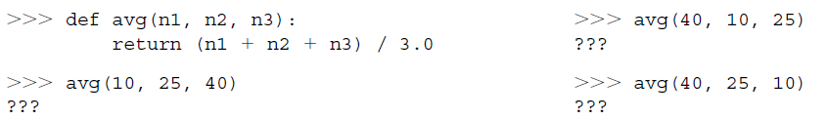
Let’s Try It

Slide 10
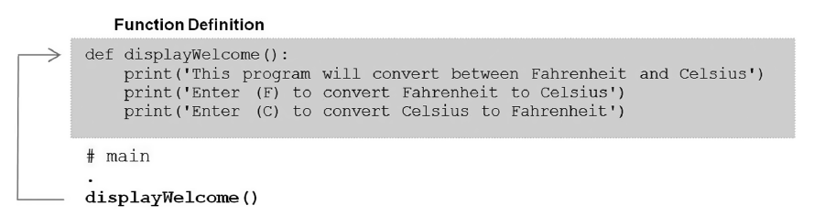
Non-Value-Returning Functions
A non-value-returning function is called not for a returned value, but for its side effects. A side effect is an action other than returning a function value, such as displaying output on the screen.

Slide 11

Let’s Try It

Slide 12
Function Calls Overview
A call to a value-returning function is an expression. It evaluates to the value returned by the function call. Thus, calls to value-returning functions are made part of a larger expression or instruction,
result = avg(10, 25, 16) * factor
A call to a non-value-returning function is a statement. Thus, calls to non-value-returning functions are written as a statement (instruction) on its own,
displayWelcome()
Technically, all functions in Python are value-returning, since functions that do not return a value return special value None.

Slide 13
More on Functions
We further discuss issues related to function use, including more on function invocation and parameter passing.

Slide 14
Calling Value-Returning Functions
Calls to value-returning functions can be used anywhere that a function’s return value is appropriate,
result = max(num_list) * 100

Slide 15
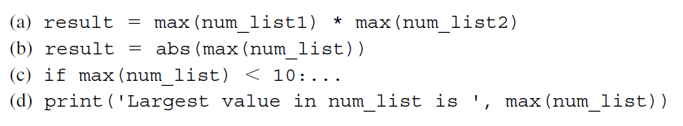
Other examples of calls to value-returning functions.
Expressions containing multiple function calls
Function call as an argument to another function call
Function call as conditional expression
Function call as part of calls to built-in print function

Slide 16
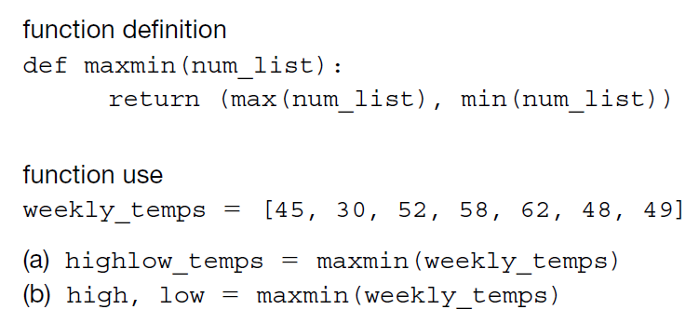
A value-returning function may return more than one value by returning the values are a tuple.
Assigns the returned tuple to variable highlow_temps
Uses tuple assignment to assign both variables high and low

Slide 17
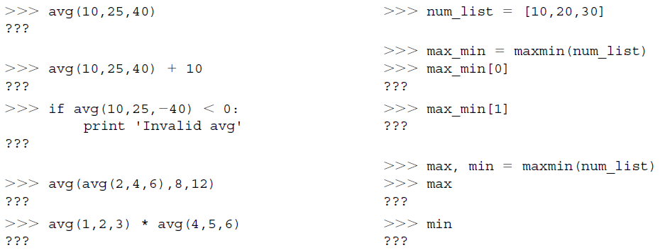
Let’s Try It

Slide 18
Calling Non-Value-Returning Functions
Calls to non-value-returning functions are for the side-effects produced, and not for a returned function value, such as displaying output on the screen,
displayWelcome()
It does not make any sense to treat this function call as an expression,
welcome_displayed = displayWelcome()

Slide 19
Functions Designed to Take No Arguments
As shown in the previous examples, both value-returning and non-value-returning functions can be designed to take no arguments.

Slide 20
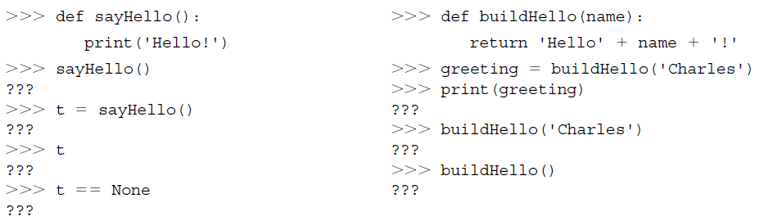
Let’s Try It

Slide 21
Parameter Passing
Parameter passing is the process of passing arguments to a function.
Recall that actual arguments are the values passed to a function’s formal parameters to be operated on.

Slide 22
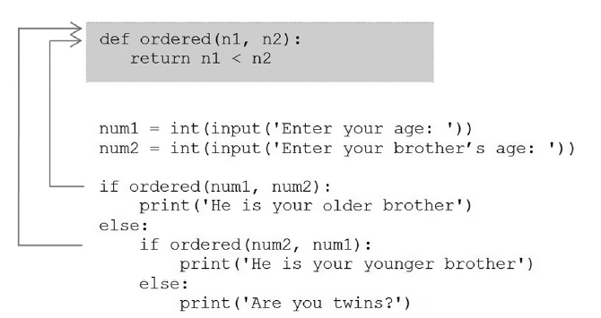
The following parameter passing is perfectly valid.
It is fine to pass actual arguments num1 and num2 to function ordered as shown (either num1 as the first argument, or num2 as the first)

Slide 23
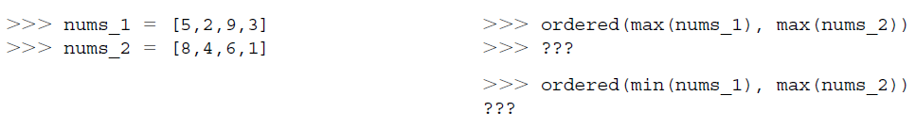
Let’s Try It

Slide 24
Mutable vs. Unmutable Arguments
There is an issue related to parameter passing not yet considered.
If a function changes the value of any of its formal parameters, does that change the value of the corresponding actual argument passed?

Slide 25
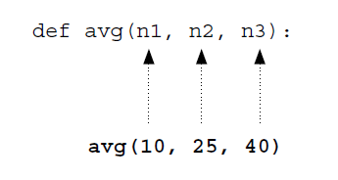
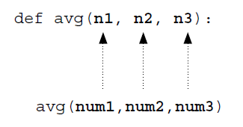
When literals are passed as arguments, there is no issue.
It is when the actual arguments are variables that this must be considered.

Slide 26
Since function avg does not change the value of its parameters, the corresponding actual parameters num1, num2 and num3 will not be altered.

Slide 27
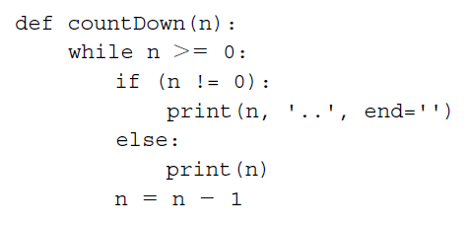

Consider, however, the following function.
This function simply displays a countdown of the provided integer parameter value. For example, function call countDown(4) produces the following output,

Slide 28
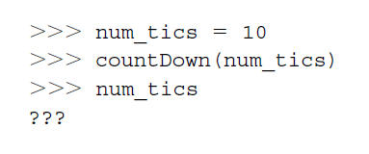
What if the function call contained a variable as the argument, for example, countDown(num_tics)? Since function countDown alters the value of formal parameter n, decrementing it until it reaches the value − 1, does the corresponding actual argument num_tics have value − 1 as well?
If you try it, you will see that variable num_tics is left unchanged.

Slide 29
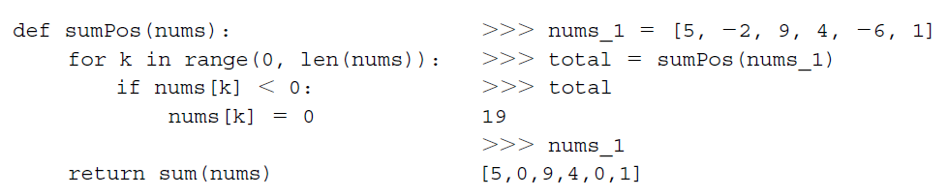
Function sumPos returns the sum of only the positive numbers in the provided argument (list). It does this by first replacing all negative values in parameter nums with 0, then summing the list using built-in function sum.
We see that the corresponding actual argument nums_1 has been altered in this case, with all of the original negative values set to 0.
The reason that there was no change in integer argument num_tics but there was in list argument nums_1 has to do with their types.

Slide 30
Immutable
mutable
Numeric Types
(integers and floats)
Boolean Type
String Type
Tuples
Lists
Dictionaries

Slide 31
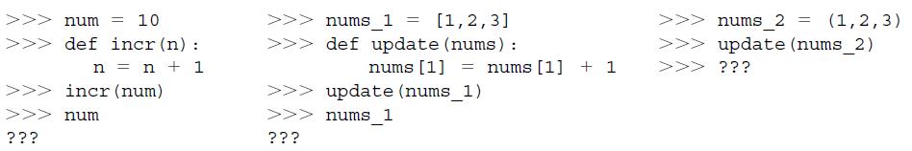
Let’s Try It

Slide 32
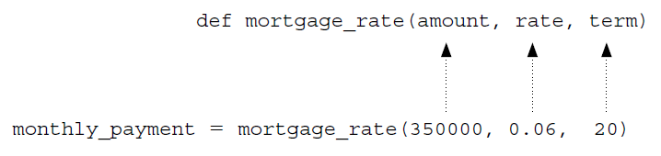
Keyword Arguments in Python
The functions we have looked at so far were called with a fixed number of positional arguments. A positional argument is an argument that is assigned to a particular parameter based on its position in the argument list,

Slide 33
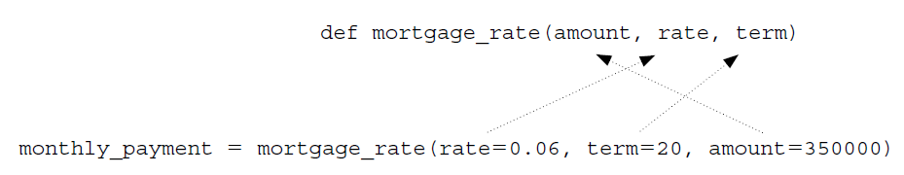
Python provides the option of calling any function by the use of keyword arguments. A keyword argument is an argument that is specified by parameter name, rather than as a positional argument.
This can be a useful way of calling a function if it is easier to remember the parameter names than it is to remember their order.

Slide 34
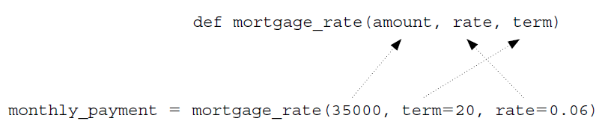
It is possible to call a function with the use of both positional and keyword arguments. However, all positional arguments must come before all keyword arguments in the function call, as shown below.
This form of function call might be useful, for example, if you remember that the first argument is the loan amount, but you are not sure of the order of the last two arguments rate and term.

Slide 35
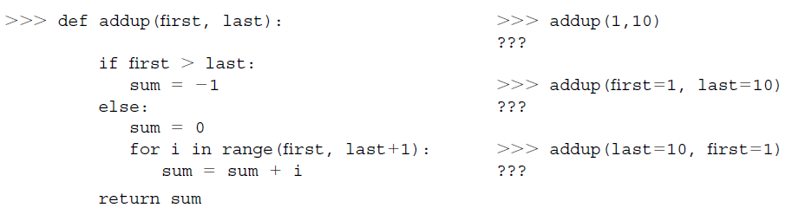
Let’s Try It
Enter the following function definition in the Python Shell. Execute the statements below and observe the results.

Slide 36
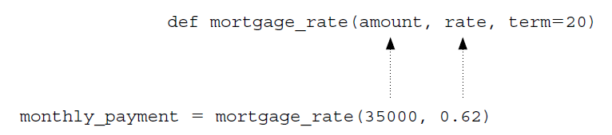
Default Arguments in Python
Python provides for default arguments. A default argument is an argument that can be optionally provided.
Parameter term is assigned a default value, 20, and therefore is optionally provided when calling function mortgage_rate. All positional arguments must come before any default arguments in a function definition.

Slide 37
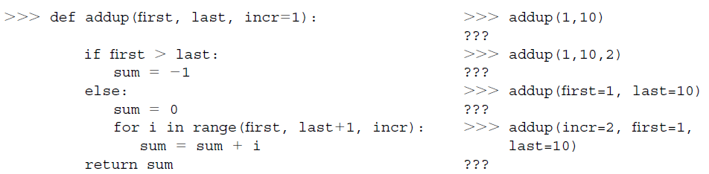

Slide 38
Variable Scope
Variable scope has to do with the parts a program that a given variable is accessible.

Slide 39
Local Scope and Local Variables
A local variable is a variable that is only accessible from within a given function. Such variables are said to have local scope. In Python, any variable assigned a value in a function becomes a local variable of the function.

Slide 40
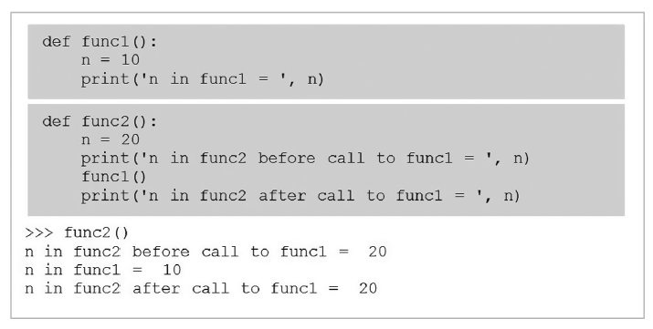
Both func1 and func2 contain identifier n. Function func1 assigns n to 10, while function func2 assigns n to 20. Both functions display the value of n when called—func2 displays the value of n both before and after its call to func1. If identifier n represents the same variable, then shouldn’t its value change to 10 after the call to func1? The execution of func2, however, shows that the value of n remains unchanged.

Slide 41
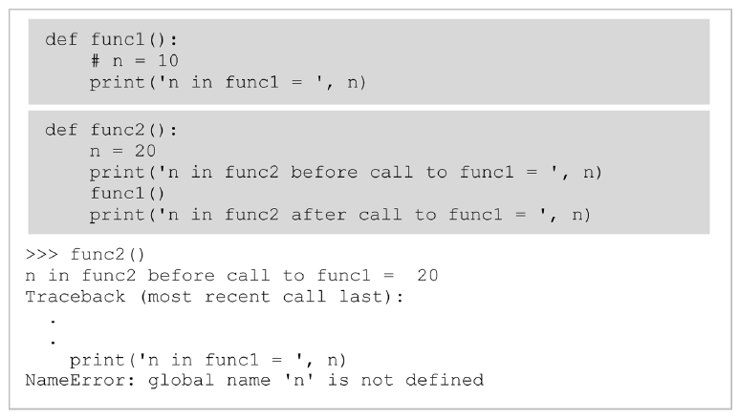
Now consider the following.
In this case, when func2 is called, we get an error that variable n is not defined within func1. This is because variable n defined in func2 is inaccessible from func1.

Slide 42
Variable Lifetime
The period of time that a variable exists is called its lifetime. Local variables are automatically created (allocated memory) when a function is called, and destroyed (deallocated) when the function terminates. Thus, the lifetime of a local variable is equal to the duration of its function’s execution. Consequently, the values of local variables are not retained from one function call to the next.

Slide 43

Let’s Try It
Enter the following function definition in the Python shell. Execute the statements below and observe the results.

Slide 44
Global Variables and Global Scope
A global variable is a variable that is defined outside of any function definition. Such variables are said to have global scope .

Slide 45
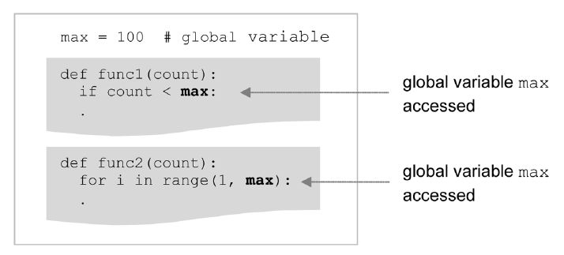
Variable max is defined outside func1 and func2, and therefore “global” to each. Thus, it is referred to as a global variable. As a result, it is directly accessible by both functions.
The use of global variables is generally considered to be bad programming style. Although it provides a convenient way to share values among functions, all functions within the scope of a global variable can access and alter it. This may include functions that have no need to access the variable, but none-the-less may unintentionally alter it.

Slide 46
Different patterns in Algorithm

Slide 47
MOTIVATION-Recursion
Almost all computation involves the repetition of steps.
Iterative control statements, such as the for and while statements, provide one means of controlling the repeated execution of instructions.
Another way is by the use of recursion.

Slide 48
Recursive algorithms
In recursive problem solving, a problem is repeatedly broken down into similar sub problems, until the sub problems can be directly solved without further breakdown.

Slide 49
Recursive algorithms
Recursive algorithms ■ The functions computed by the algorithms are expressed in terms of itself ■ Example Task: Find the Factorial of a positive integer

Slide 50
Recursive algorithms
Algorithm:
Algorithm Factorial(n)
Begin if (n=1) than return 1 else return(n * Factorial(n-1)) End

Slide 51
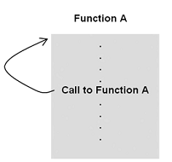
What Is a Recursive Function?
A recursive function is often defined as “a function that calls itself.”

Slide 52
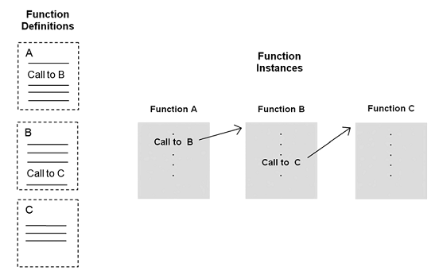
General mechanism of non-recursive function

Slide 53
Recursive function execution instances
Execution of a series of recursive function instances is similar to the execution of series of non-recursive instances, except that the execution instances are “clones” of each other (that is, of the same function definition).

Slide 54
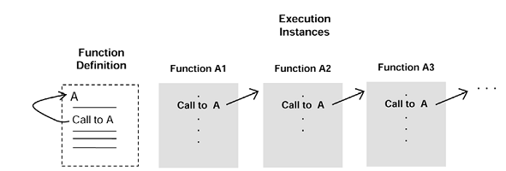

Slide 55
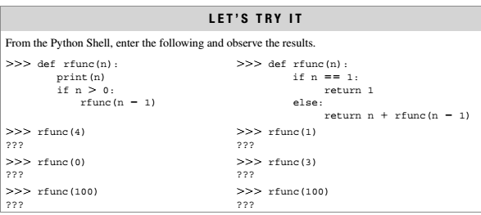

Slide 56
Example: Factorial
Problem:
The factorial function is an often-used example of the use of recursion. The computation of the factorial of 4 is given as,
factorial(4) = 4 * 3 * 2* 1= 24
In general, the computation of the factorial of any (positive, nonzero) integer n is,
factorial(n) = n . (n-1). (n-2) . . . 1
The one exception is the factorial of 0, defined to be 1.

Slide 57
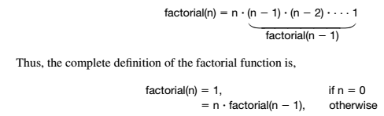
logic
The factorial of n can be defined as n times the factorial of n – 1

Slide 58

A Recursive Factorial Function Implementation
Input
Factorial(4)

Slide 59
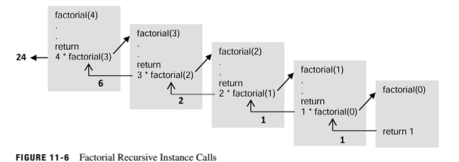
Factorial Recursive Instance Calls

Slide 60
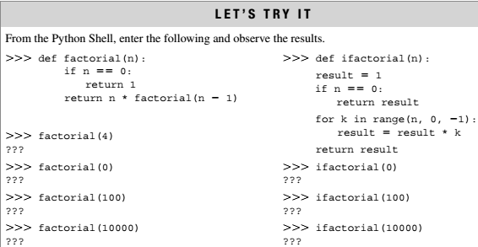

Slide 61
def fibo(n):
if n <= 1:
return n
else:
return(fibo(n-1) + fibo(n-2))
nterms = 10
if nterms <= 0:
print("Plese enter a positive integer")
else:
print("Fibonacci sequence:")
for i in range(nterms):
print(fibo(i))

